Slide 1
Root zone soil moisture products based on scatterometer data assimilation
EUMETRAIN event week
David Fairbairn, Patricia de Rosnay, Phil Browne, Lars Isaksen and Clement Albergel

Slide 2
Contents
Introduction and background
NRT root-zone soil wetness index product (H14)
Data record root-zone soil wetness index product (H27 and H140)
4. Format and documentation
5. Summary and future products

Slide 3
Introduction

Slide 4
I have a land surface DA position at ECMWF, funded by H SAF (started in 2017) ;
H SAF aims to provide satellite products with sufficient time/spatial resolutions to satisfy needs of operational hydrology;
ECMWF provides the core root-zone soil moisture (RZSM) products for H SAF using an advanced land-surface data assimilation system, running independently of the NWP system;
Currently, there are two operational H SAF RZSM products:
A global near-real-time SM product at 25 km resolution, delivered daily (called H14);
2. A global data record SM product (1992-2016) at 16 km resolution forced by ERA-Interim atmospheric fields, consisting of H27 (1992-2014) and H140 (2015-2016).

Slide 5
Introduction to data assimilation

Slide 6
ASCAT-derived observations
Satellite derived global observations from the Advanced Scatterometer (ASCAT) measure the top few centimetres of soil;
Soil moisture derived from C-band low-frequency microwave signal using the change detection technique (Wagner et al., 1999; Bartalis et al., 2007);
ASCAT-derived surface soil moisture (SSM) observations are generally quite accurate (Unbiased RMSE of ~ 0.04 m³/m³ according to Brocca et al. (2010));
However, frequency of the observations is limited by the temporal sampling of the satellite swath (~ every 2 days globally);
Observations are not able to detect frozen soil moisture content and are unreliable in highly vegetated regions (e.g. Amazon rainforest) and mountainous regions (e.g. Himalayas).
Notes:
6

Slide 7
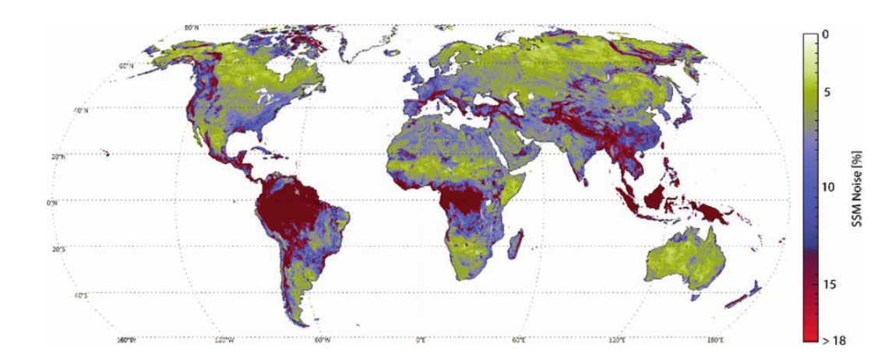
ASCAT observation accuracy
Estimate of noise (%) in ASCAT-derived observations. From Figure 6 of Wagner et al (2013). Based upon the methods presented in Naiemi et al. (2009).
Most areas have a high signal-to-noise ratio. But observations in highly vegetated regions and mountainous regions are noisy.

Slide 8
Land surface models
Land surface models (LSMs) provide continuous and spatially complete estimates of root-zone soil moisture and other land related variables e.g. snow. They are forced by atmospheric variables, notably precipitation and radiative forcing;
Atmospheric forcing for LSMs typically comes from reanalyses or a Numerical Weather Prediction forecast;
LSMs require parameterizations (e.g. soil texture, vegetation type), which are not always accurate;
Errors in root-zone soil moisture from LSMs are significant in some regions due to model errors and/or errors in the atmospheric forcing.

Slide 9
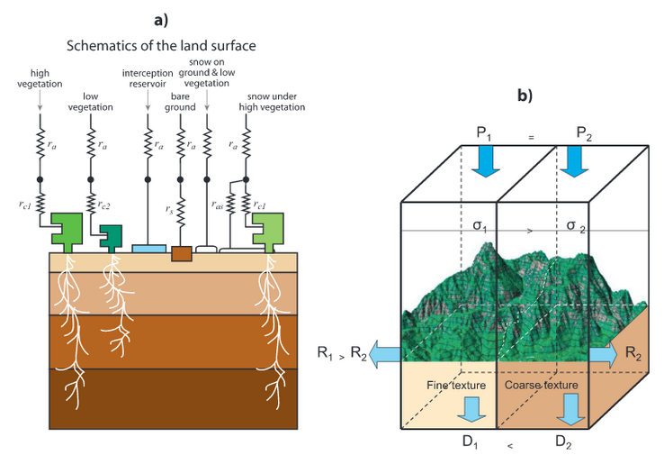
H-TESSEL land surface model
Figure 1: Schematic representation of the structure of (a) TESSEL land-surface scheme and (b) spatial structure added for H-TESSEL. From Balsamo et al (2009).

Slide 10
Data assimilation
Data assimilation (DA) aims to optimally combine observations with a model simulation, by weighting them according to their respective uncertainties;
ASCAT-derived SSM observations are accurate in many regions, but are unreliable in certain areas and not frequent enough for some operational applications;
The LSM ensures a continuous and complete global coverage of root-zone soil moisture, but suffers from model/forcing errors;
The DA algorithm assimilates the ASCAT-derived SSM observations into the LSM, enabling the ASCAT observations to improve the entire root-zone soil moisture profile (0-1 m), while maintaining a continuous and complete global coverage.

Slide 11
Section 1 NRT root-zone soil wetness index product (H14)

Slide 12
H14 NRT root-zone SWI
H14 is the near-real-time (NRT) root-zone soil wetness index (SWI) product at 25 km resolution and is bounded between 0 (residual soil moisture) and 1 (saturation);
H14 consists of global daily (00 UTC) grib files of the four model layers and a quality control flag (since October 2018). It has a latency of 12-36 hours;
H14 is produced by assimilating a near-real-time (NRT) ASCAT-A/B derived SSM product (H102/H103) into the H-TESSEL LSM using a simplified Extended Kalman Filter (SEKF, de Rosnay et al, (2012)). It is run independently of the ECMWF NWP system;
Additionally, H14 assimilates observations of 2m temperature and humidity, which ensures consistency between the land surface and the near-surface atmospheric conditions.

Slide 13
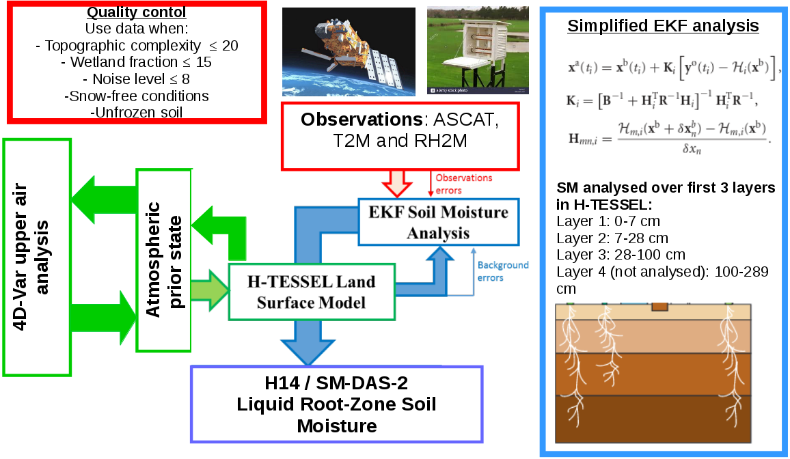
H14 data assimilation
- 12 hour assimilation windows
- Produced daily at 00 UTC (12-36 hour latency)

Slide 14
H14 data assimilation
SEKF based on de Rosnay et al, (2012);
B is diagonal, with background-error standard deviation 0.01 m³m⁻³ for each layer;
R is diagonal, with observation-error standard deviation 0.05 m³m⁻³ for ASCAT-derived SSM, 1 K for 2 m temperature and 4% for relative humidity.

Slide 15
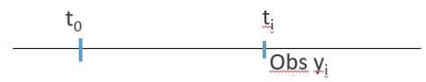
H14 data assimilation
Jacobian elements H_{mn} for analysis variable n and observation m calculated using finite differences:

Slide 16
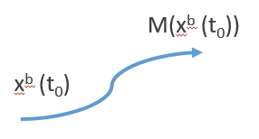
H14 data assimilation
Jacobian elements H_{nm} for analysis variable n and observation m calculated using finite differences:

Slide 17
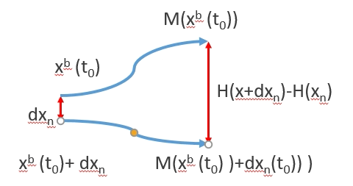
H14 data assimilation
Jacobian elements H_{nm} for analysis variable n and observation m calculated using finite differences:

Slide 18
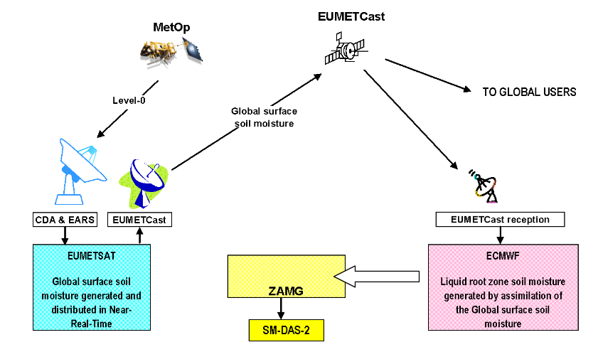
H14 production chain
H14/SM-DAS-2

Slide 19
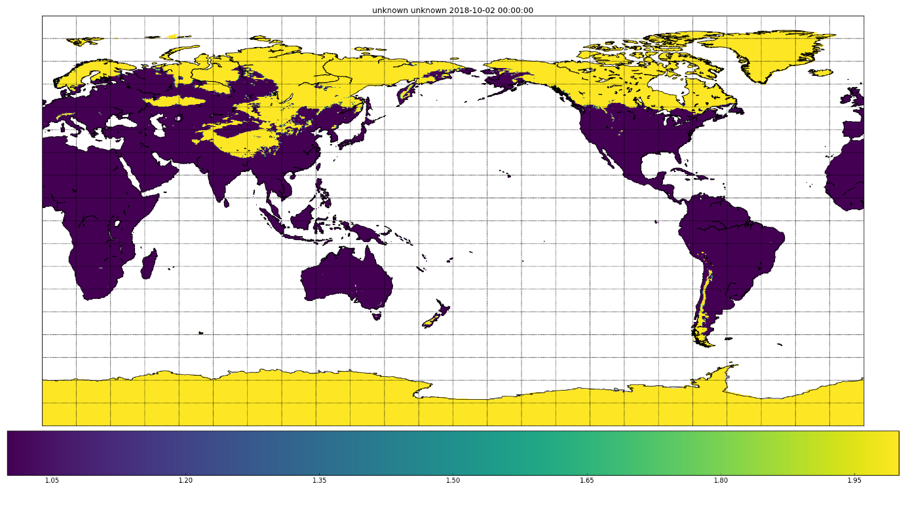
H14 quality control
The assimilated ASCAT-derived SSM observations (H102/H103) already undergo a rigorous quality control screening (see Sebastian Hahn’s presentation);
On 4/10/18, a quality control flag was introduced for H14, which identifies grid points where there is a risk of frozen conditions (modelled soil temperature in any layer < 4°C):
H14 QC flag for 04/10/18
QC code:
1 = normal;
2 = risk of frozen conditions;
3 = outside nominal range (0-1)
Purple=normal conditions, Yellow=risk of frozen conditions

Slide 20
CDOP-3 developments
Current H14 NRT 25 km product used in operational hydrological modelling/flood prediction (e.g. Artinyan, 2012, Massari, 2015). Also input for LANDSAF evapotranspiration estimates by Portuguese Met Agency (IMPA);
Improvements to resolution/timeliness of H14 would be beneficial for end users;
Future H26 NRT product:
Resolution to be increased from 25 km to 10 km;
Latency to be reduced from 36 hours to 12 hours;
Output in netCDF (regular lat-lon) and grib (original reduced Gaussian grid);
Assimilation of ASCAT-C soil moisture (currently cal/val ongoing);
New stand-alone surface analysis in H26, evaluated by Fairbairn et al., 2019.

Slide 21
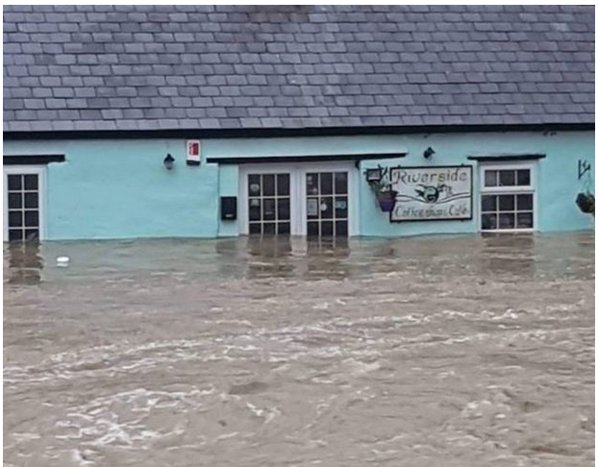
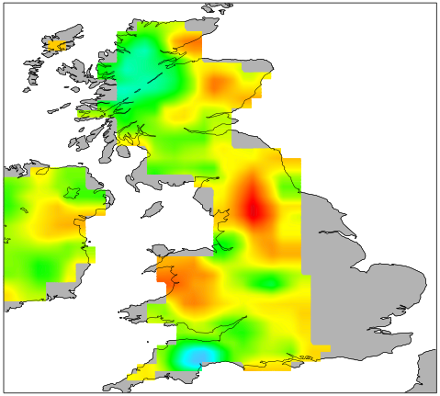
Case study – Storm Callum
Storm passed the UK on 12th/13th October 2018;
Pressure deepened to 938 hPa (exceptional for midlatitude storm);
86 mph recorded at Capel Curig in Wales;
>200 mm of rainfall in 24 hours over parts of Wales - Worst flooding for 30 years;
Timeline of heavy precipitation reflected in ASCAT soil wetness index:
https://www.bbc.co.uk/news/uk-wales-45838058
00UTC 11/10/18:

Slide 22
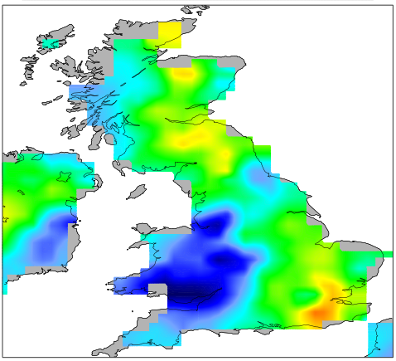
Case study – Storm Callum
Storm passed the UK on 12th/13th October 2018
Pressure deepened to 938 hPa (exceptional for midlatitude storm);
86 mph recorded at Capel Curig in Wales
>200 mm of rainfall in 24 hours over parts of Wales - Worst flooding for 30 years;
Timeline of heavy precipitation reflected in ASCAT soil wetness index:
https://www.bbc.co.uk/news/uk-wales-45838058
00UTC 11/10/18:
12UTC 12/10/18:

Slide 23
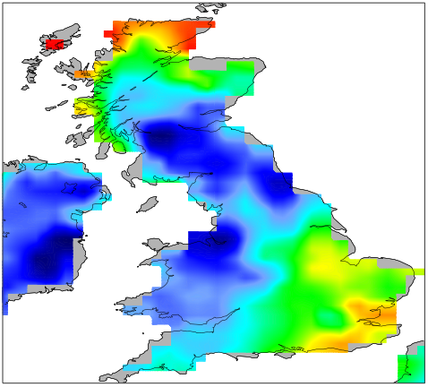
Case study – Storm Callum
Storm passed the UK on 12th/13th October 2018
Pressure deepened to 938 hPa (exceptional for midlatitude storm);
86 mph recorded at Capel Curig in Wales
>200 mm of rainfall in 24 hours over parts of Wales - Worst flooding for 30 years;
Timeline of heavy precipitation reflected in ASCAT soil wetness index:
https://www.bbc.co.uk/news/uk-wales-45838058
00UTC 11/10/18:
12UTC 12/10/18:
12UTC 13/10/18:

Slide 24
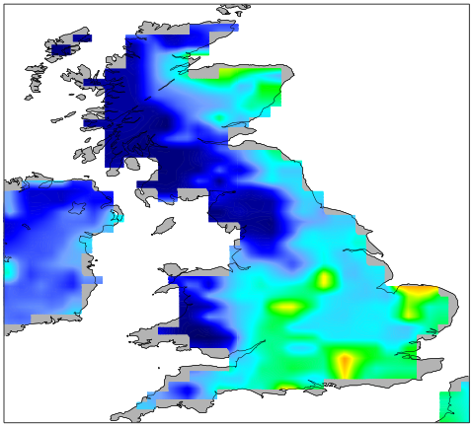
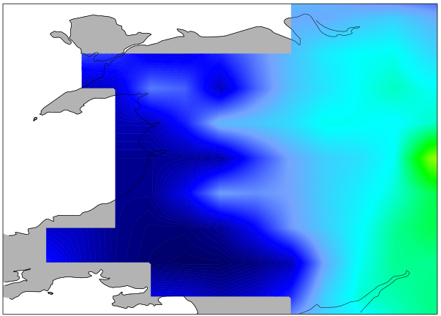
Case study – Storm Callum
H14 (25 km res)
Saturated H14 root-zone soil wetness index across western UK
Large scale west-east gradient well captured, but lacks detail
Soil wetness index on 13/10/19 at 00 UTC

Slide 25
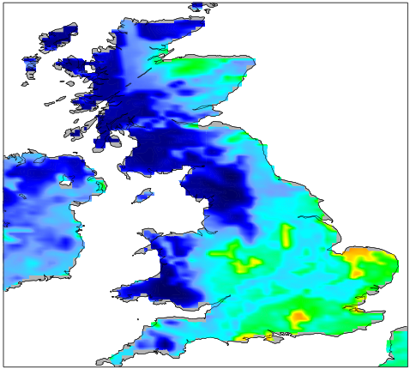
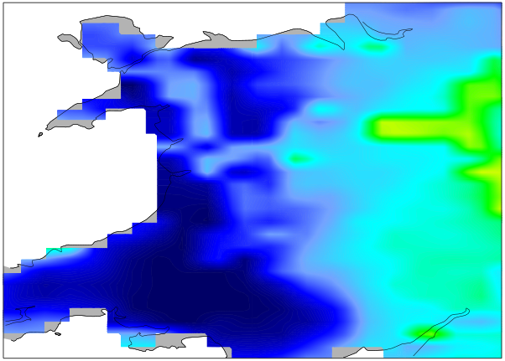
Case study – Storm Callum
H14 (25 km res)
Saturated H14 root-zone soil wetness index across western UK
Large scale west-east gradient well captured, but lacks detail
Soil wetness index on 13/10/19 at 00 UTC
H26 (10 km res)
Fine scale features much better captured in H26 than H14, including orographic enhancement and coastal areas over South Wales

Slide 26
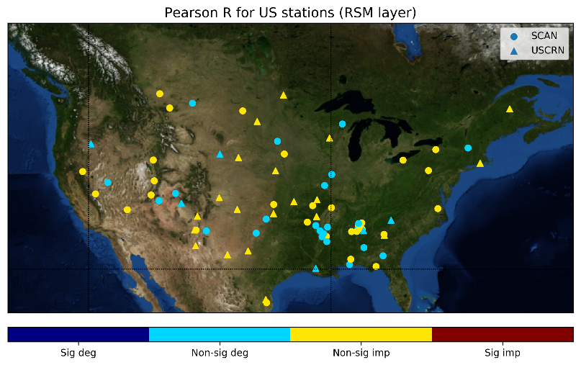
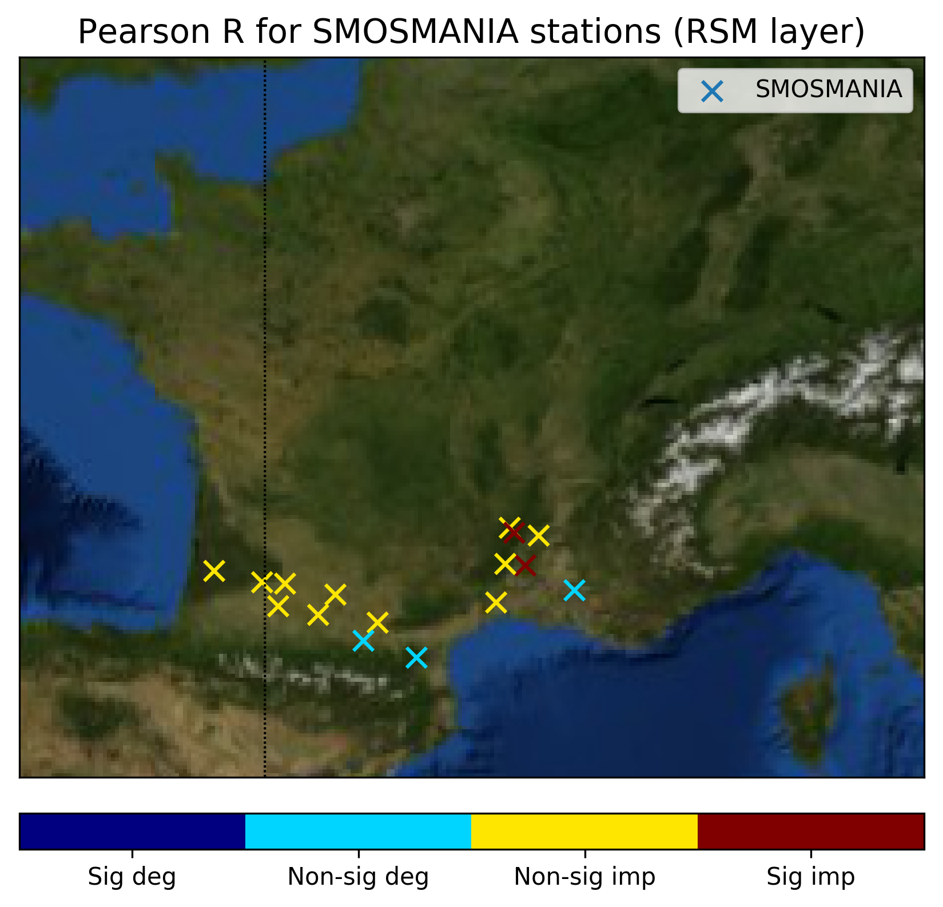
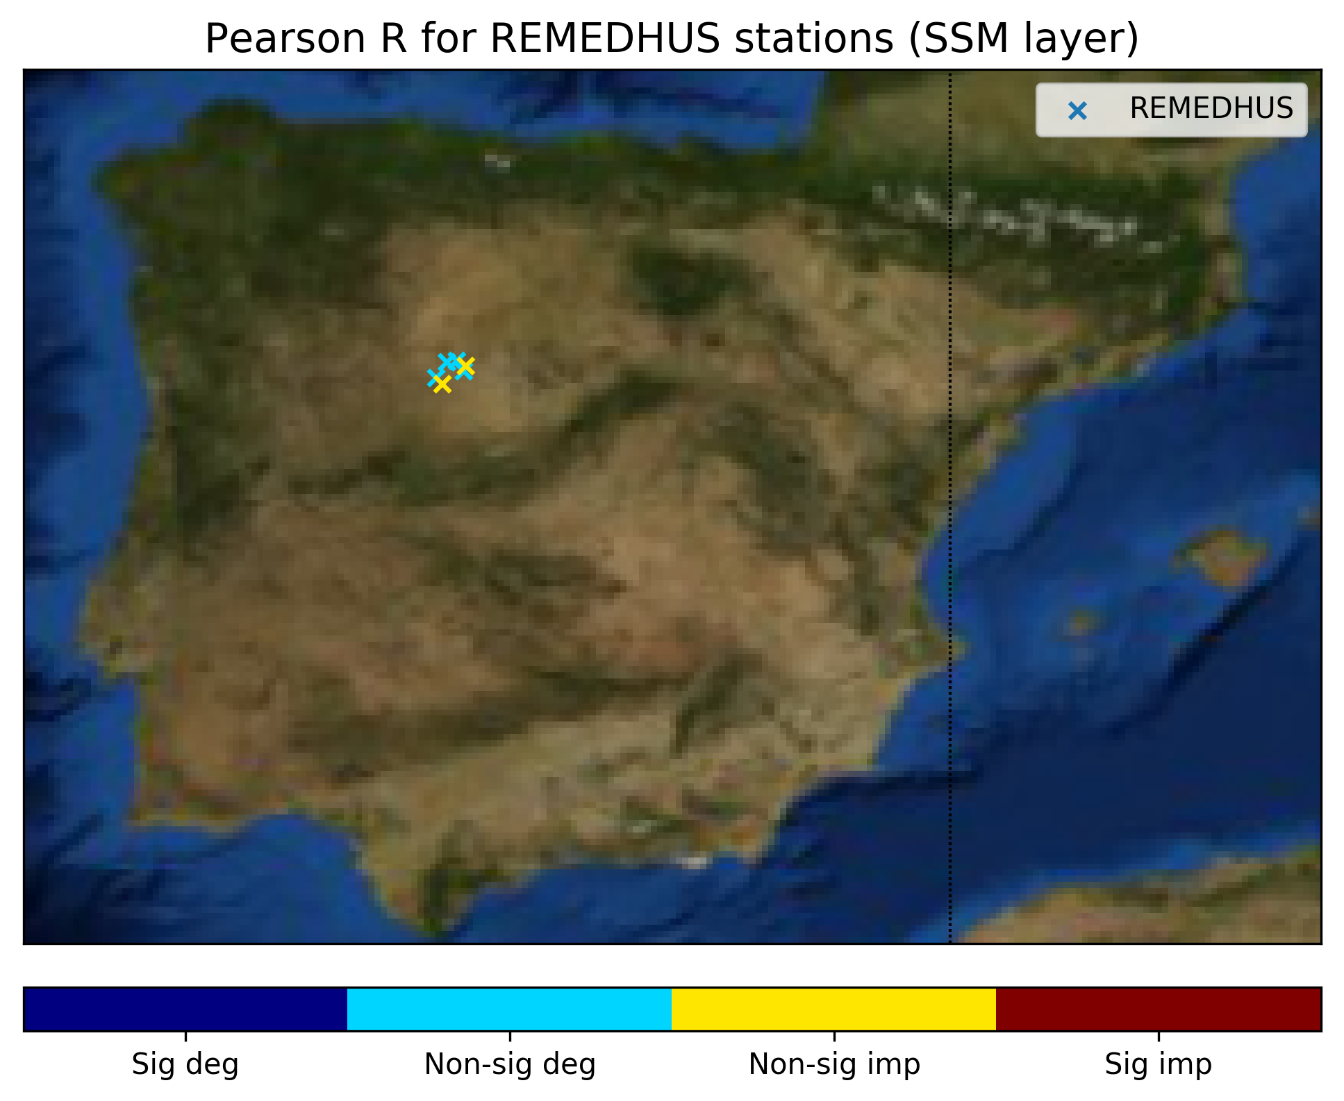
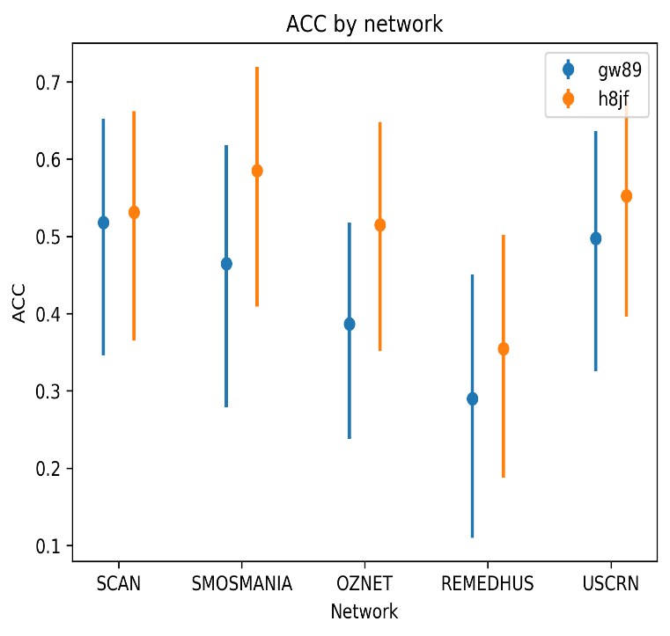
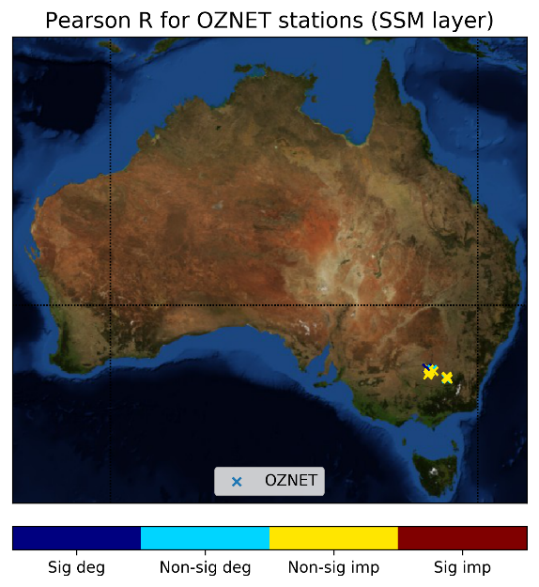
Validation of H14 and H26
Validation using in situ SM networks from the international SM network (Dorigo et al., 2011) around the world over period (1/6/18-31/10/18): USCRN, SCAN (US), SMOSMANIA (France), REMEDHUS (Spain), OZNET (Australia).
Root-zone Anomaly CC (H26 vs H14):
 | H14 (25 km res) | H26 (10 km res)
ACC (-) | 0.63 | 0.68
RMSD (m3/m3) | 0.029 | 0.027
H26 improves on H14

Slide 27
Section 2 Data record root-zone soil wetness index product (H27/H140)

Slide 28
H27/H140 data record products
H27/H140 are the root-zone soil wetness index (SWI) data record products (1992-2016) at 16 km resolution. H27 covers the period (1992-2014) and H140 covers the period (2015-2016);
H27/H140 consist of global daily (00 UTC) grib files of the four model layers;
H27/H140 are produced by assimilating a reprocessed version of ERS-scatterometer (1992-2006) from TuWien and ASCAT-A SSM observations from EUMETCAST (2007-2016), as well as SLV observations (1992-2016);
H27/H140 use an offline version of the ECMWF LDAS with ERA-interim atmospheric forcing.

Slide 29
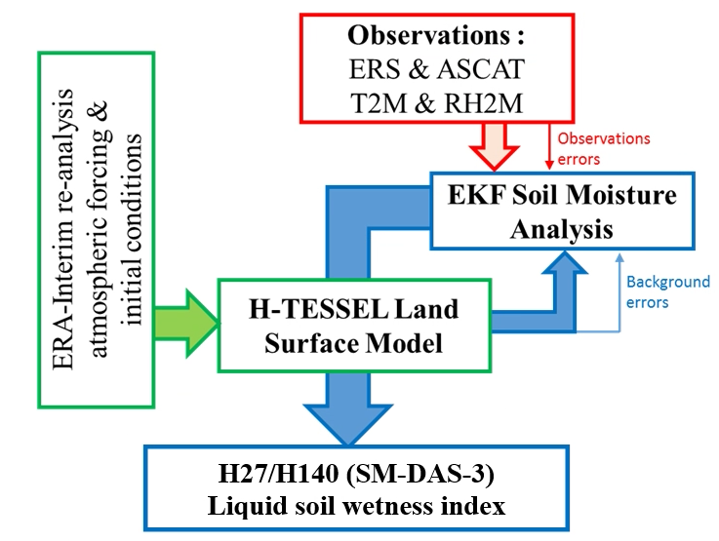
H27/H140 data assimilation

Slide 30
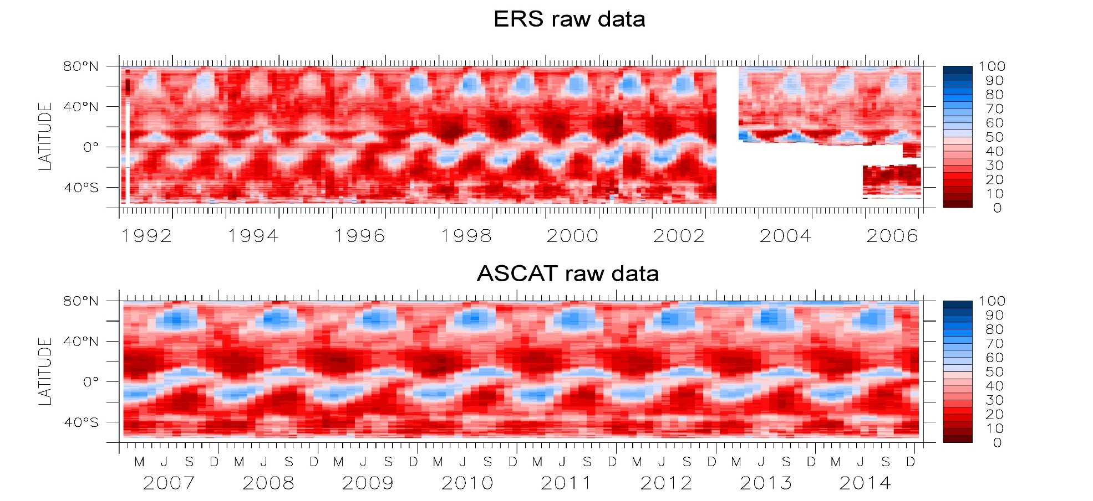
Scatterometer data coverage
Longitudinal monthly mean of satellite derived surface soil moisture from the ERS-1/2 (top) and ASCAT-A (bottom) over 1992-2006 and 2007-2014, respectively.

Slide 31
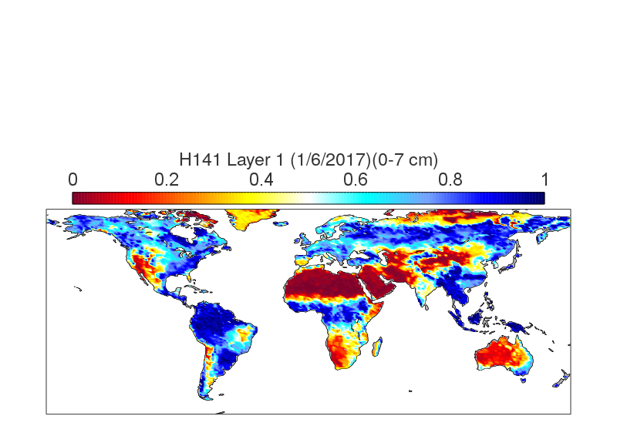
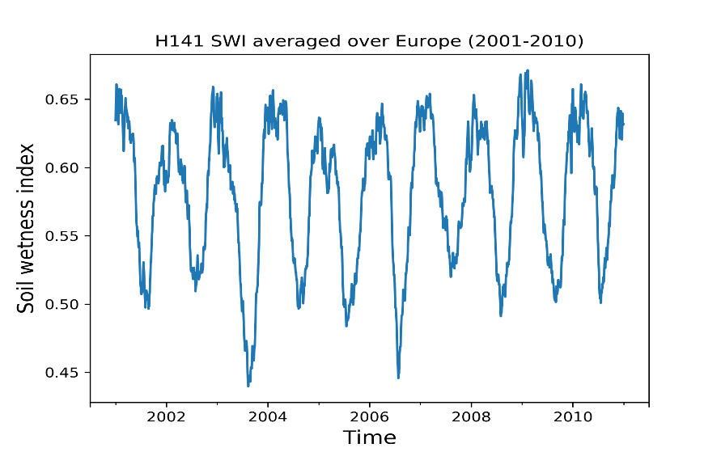
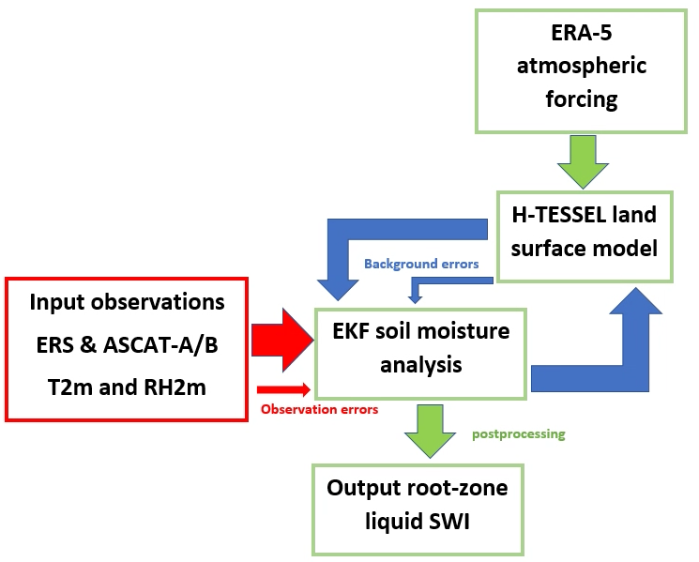
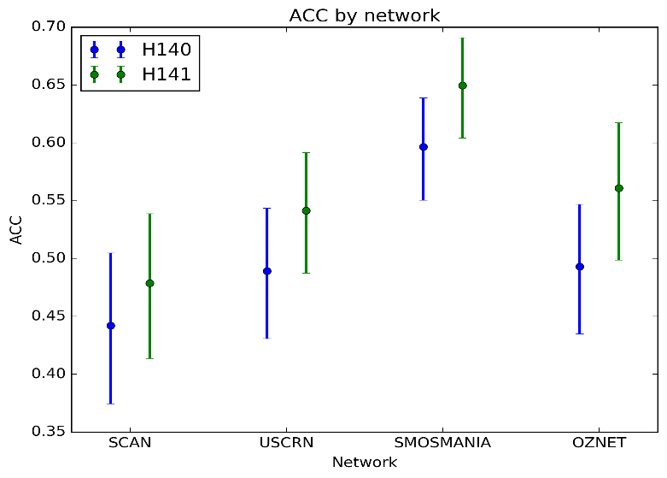
New H SAF RZSM data record (1992-2018)
H141: Global liquid soil wetness index available daily from 1992-2018 (at 00 UTC);
Produced using offline version of IFS land data assimilation forced by ERA-5;
Assimilates pre-processed scatterometer observations (1992-2018);
Improves on H140 through increased res (10 km instead of 25 km) and improved atmospheric forcing (ERA-5 instead of ERA-interim);
Improved correlations of H141 against in situ observations compared with H140.

Slide 32
Section 3 Format and documentation

Slide 33
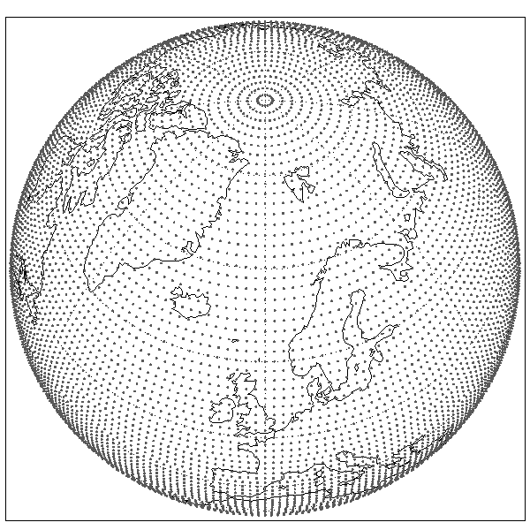
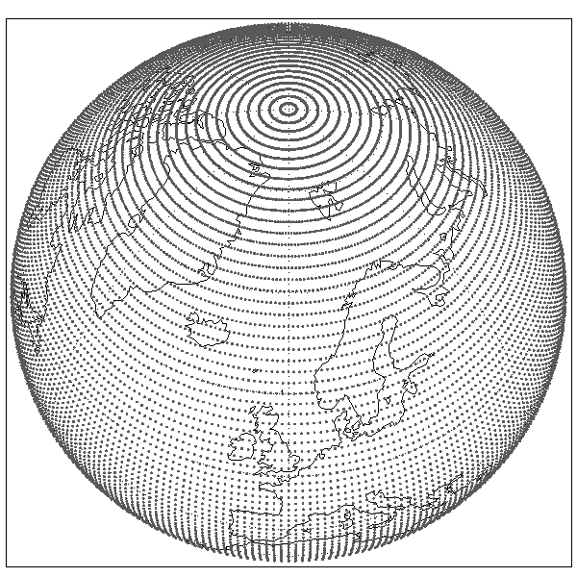
Format
H14 is available in grib format on a linear reduced Gaussian grid (T799~25 km resolution);
H27/H140 are available in grib format at (T1279~16 km resolution).
The reduced Gaussian grid maintains approximately equidistant grid-point distances between the poles and the equator (unlike regular lat/lon grid):
Reduced Gaussian grid:
Regular lat/lon grid:
For more info, see https://confluence.ecmwf.int/display/FCST/Gaussian+grids

Slide 34
Download and documentation
H14, H27 and H140 daily grib files can be downloaded via the H SAF ftp: ftp://ftphsaf.meteoam.it/products
Register with H SAF: http://hsaf.meteoam.it/user-registration.php to obtain username and password
The documentation can be found via http://hsaf.meteoam.it/user-documents.php:
Product user manual
Algorithm theoretical baseline document
Product validation report
If you have queries about the products or website, please contact the H SAF helpdesk: us_hsaf@meteoam.it

Slide 35
Citation of H SAF RZSM products
How to cite H27 (DRR 1992-2014):
H SAF, “Scatterometer Root Zone Soil Moisture Data Record (1992-2014) at 16 km resolution, based on ERS/SCAT and Metop ASCAT assimilation (H27).” EUMETSAT SAF on Support to Operational Hydrology and Water Management, 2015, DOI: 10.15770/EUM_SAF_H_0003
For H140, one can simply cite H27 and state that H140 serves as the extension to H27 for 2015-2016.
For H14 (near-real-time), one can cite the original validation performed by Clement Albergel:
Albergel, C., 2011 Product Validation Report (PVR-H14). URL: http://hsaf.meteoam.it/documents/PVR/SAF_HSAF_PVR-14.pdf. Last accessed November 2019.

Slide 36
Section 5 Summary and future work

Slide 37
Summary
The ECMWF land data assimilation system combines SSM observations with a land surface model in order to improve the root-zone soil moisture profile;
The H14 NRT root-zone SWI product assimilates ASCAT-A/B derived SSM observations and SLV observations into the H-TESSEL LSM at ECMWF;
H14 uses a NRT atmospheric forecast to force the LSM, but is run independently of the NWP system;
H14 is available daily at 25 km resolution (since 2012);
H27/H140 data record SWI products assimilate reprocessed ERS-scatterometer (1992-2006), ASCAT-A SSM observations (2007-2016) and SLV observations, at 16 km resolution;
The products are available to download on the H SAF ftp in grib format.

Slide 38
Future products
Future NRT product:
Future NRT product (H26) will benefit from increased resolution (25 to 10 km), improved timeliness (36 hours 12 hours) and ASCAT-C assimilation;
Case study for storm Callum over UK (October 2018) demonstrates importance of finer resolution in H26 compared with H14;
Preliminary validation using in situ observations over US, France, Spain and Australia indicated better performance of H26 compared to H14;
Operational release of H26 expected in 2020 (after one-year pre-operational phase).

Slide 39
Future products
Future NRT product:
Future NRT product (H26) will benefit from increased resolution (25 to 10 km), improved timeliness (36 hours 12 hours) and ASCAT-C assimilation;
Case study for storm Callum over UK (October 2018) demonstrates importance of finer resolution in H26 compared with H14;
Preliminary validation using in situ observations over US, France, Spain and Australia indicated better performance of H26 compared to H14;
Operational release of H26 expected in 2020 (after one-year pre-operational phase).
New data record product
Data record product assimilates scatterometer-derived SM into H-TESSEL land surface model using an offline land data assimilation system;
Future data record product (H141) will benefit from increased resolution (25 to 10 km) and improved atmospheric forcing (ERA-5 instead of ERA-interim);
H141 expected to be released in 2019 (subject to external reviews).

Slide 40
References
Albergel, C., 2011 Product Validation Report (PVR-14). URL: http://hsaf.meteoam.it/documents/PVR/SAF_HSAF_PVR-14.pdf. Last accessed November 2019.
Artinyan, E. 2012: Assimilation of small-scale surface soil moisture (H-SAF H08) into a coupled SVAT and hydrological model system. 2012 Eumetsat Meteorological satellite conference, 3-7 September, 2012, Sopot, Poland********* poster presentation
Balsamo, G., A. Beljaars, K. Scipal, P. Viterbo, B. van den Hurk, M. Hirschi, and A. Betts, 2009: A revised hydrology for the ECMWF model: Verification from field site to terrestrial water storage and impact in the Integrated Forecast System. J. Hydrometeor., 10, 623–643, https://doi.org/10.1175/ 2008JHM1068.1.
Baguis, P. and Roulin, E., 2017. Soil Moisture Data Assimilation in a Hydrological Model: A Case Study in Belgium Using Large-Scale Satellite Data. Remote Sensing, 9(8), p.820.
Bartalis, Z., Wagner, W., Naeimi, V., Hasenauer, S., Scipal, K., Bonekamp, H., Figa, J. and Anderson, C., 2007. Initial soil moisture retrievals from the METOP‐A Advanced Scatterometer (ASCAT). Geophysical Research Letters, 34(20).
Brocca, L., Melone, F., Moramarco, T., Wagner, W. and Hasenauer, S., 2010. ASCAT soil wetness index validation through in situ and modeled soil moisture data in central Italy. Remote Sensing of Environment, 114(11), pp.2745-2755.
de Rosnay, P., M. Drusch, D. Vasiljevic, G. Balsamo, C. Albergel, and L. Isaksen, 2013: A simplified extended Kalman filter for the global operational soil moisture analysis at ECMWF. Quart. J. Roy. Meteor. Soc., 139, 1199–1213, https://doi.org/ 10.1002/qj.2023.
Dorigo, W.A., Wagner, W., Hohensinn, R., Hahn, S., Paulik, C., Xaver, A., Gruber, A., Drusch, M., Mecklenburg, S., van Oevelen, P., Robock, A., and Jackson, T., Jackson, T. (2011). "The International Soil Moisture Network: A data hosting facility for global in situ soil moisture measurements", Hydrology and Earth System Sciences 15 (5), pp. 1675-1698.
Fairbairn, D., de Ronsay, P. and P. Browne, “The new stand-alone surface analysis at ECMWF: Implications for land-atmosphere DA coupling,” J. Hydrometeor., doi: 10.1175/JHM-D-19-0074.1, 2019

Slide 41
References
H SAF, “Scatterometer Root Zone Soil Moisture Data Record (1992-2014) at 16 km resolution, based on ERS/SCAT and Metop ASCAT assimilation (H27).” EUMETSAT SAF on Support to Operational Hydrology and Water Management, 2015, DOI: 10.15770/EUM_SAF_H_0003
Massari, C., Brocca, L., Ciabatta, L., Moramarco, T., Gabellani, S., Albergel, C., De Rosnay, P., Puca, S. and Wagner, W., 2015. The use of H-SAF soil moisture products for operational hydrology: flood modelling over Italy. Hydrology, 2(1), pp.2-22.
Naeimi, V., Bartalis, Z. and Wagner, W., 2009. ASCAT soil moisture: An assessment of the data quality and consistency with the ERS scatterometer heritage. J. Hydrometeor., 10(2), pp.555-563.
Struzik, P. and Kępińska-Kasprzak, M., 2016. Use of conventional and satellite data for estimation of evapotranspiration spatial and temporal pattern. Meteorology Hydrology and Water Management. Research and Operational Applications, 4.

